Slide 2
euRopean bio Economy aLliancE in Farming
RELIEF will boost the potential of Higher Education (HE) and Vocational Education and Training (VET) models to provide new training approaches, innovative learning material, and training practices in the field of bio-economy to open up new learning opportunities for the embedding of bio-economy principles and practices in farming.
RELIEF will train a new generation of HE students and professionals with skills (including technical, economic and regulatory knowledge) which are required by the current and future European sustainable bioeconomy.

Slide 3
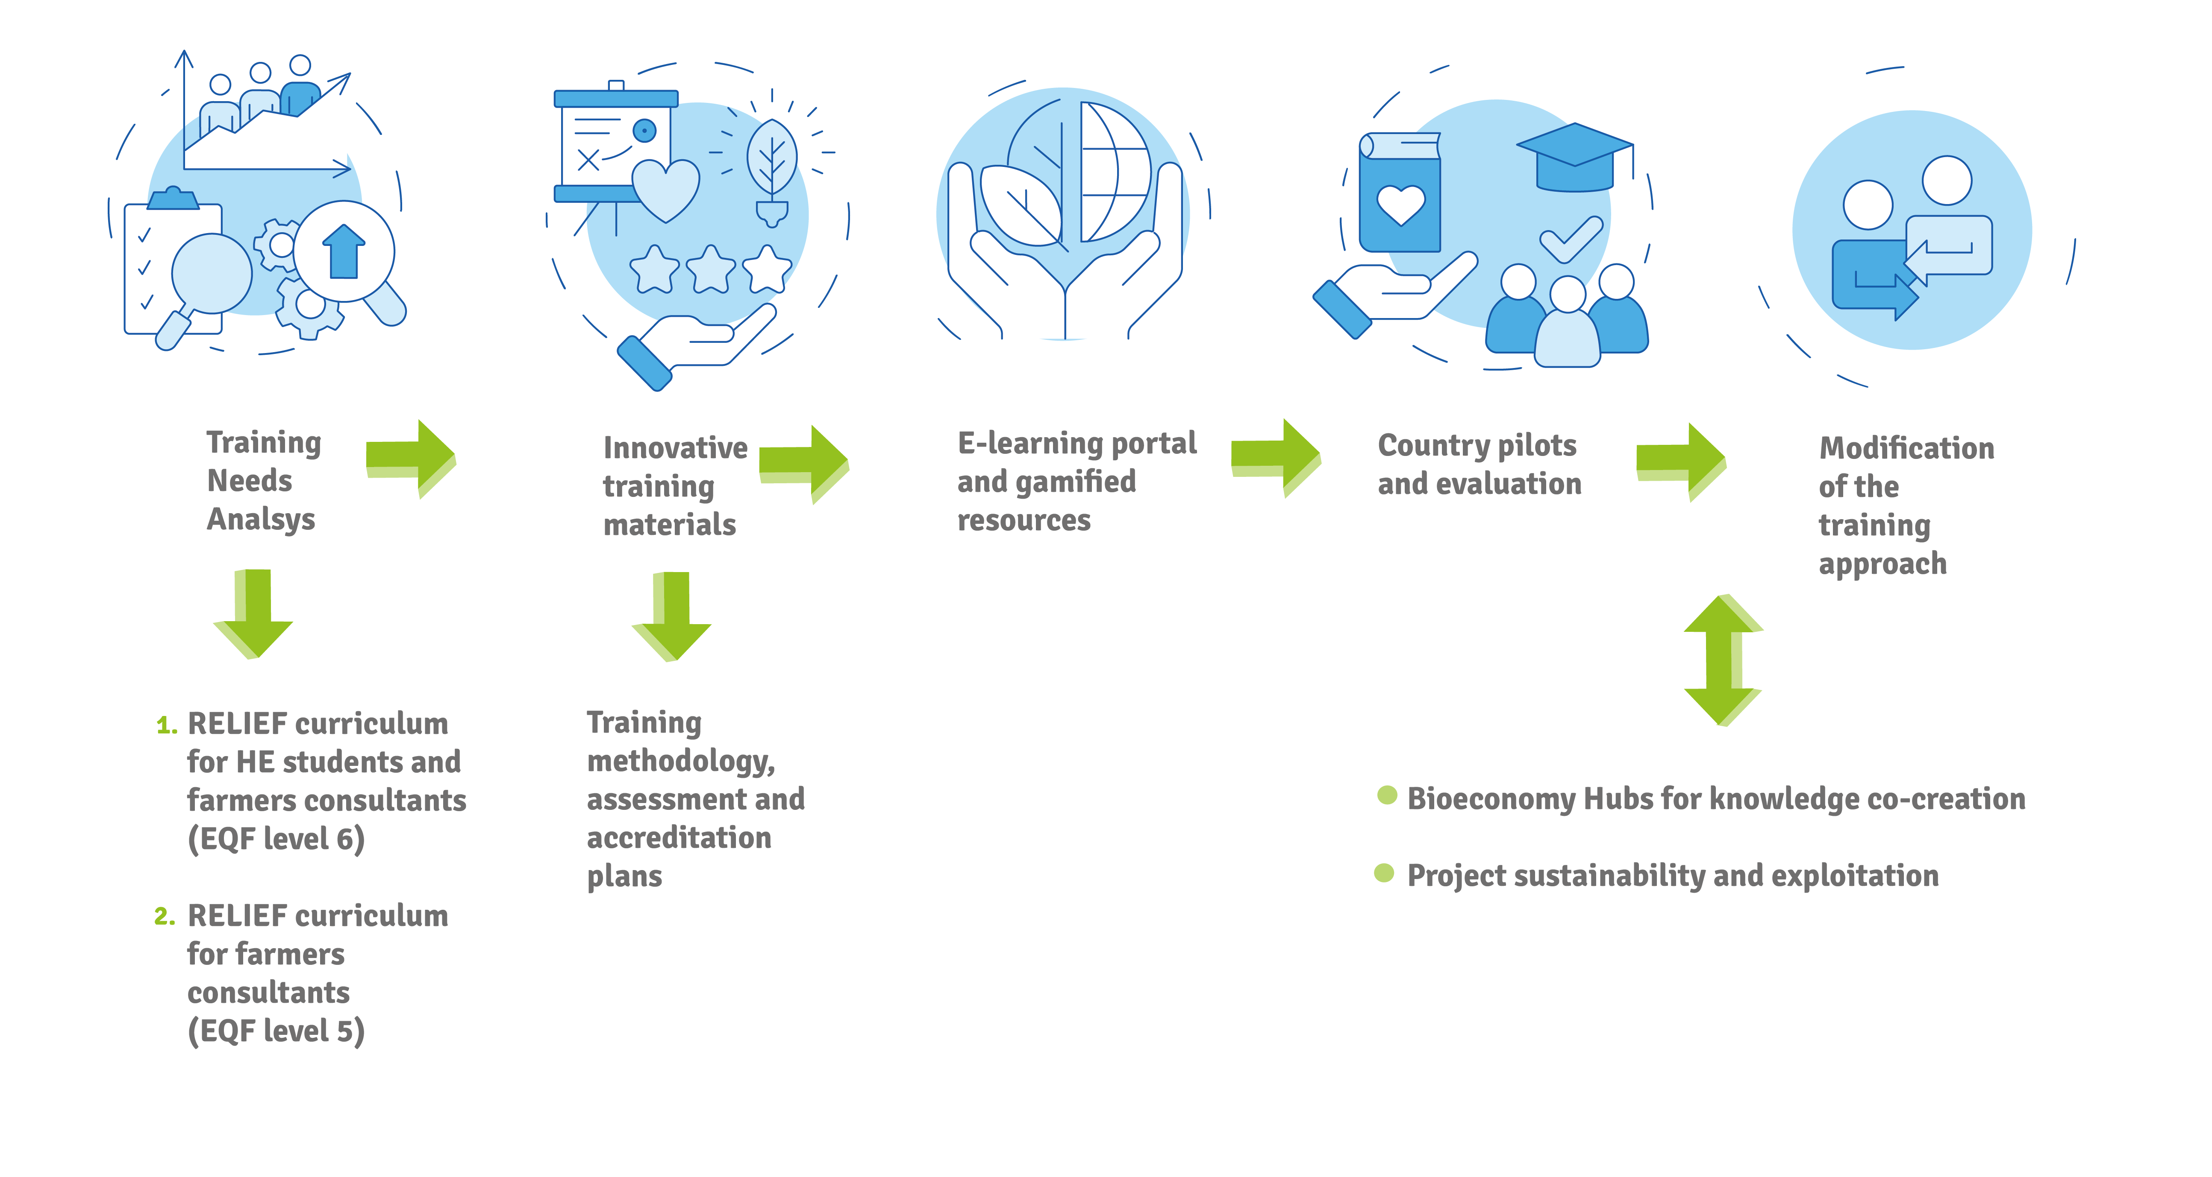
RELIEF work

Slide 4
RELIEF Expected Outcomes and Impacts
design a training approach starting from the skills needed to facilitate the transition of farming sector to bioeconomy;
enhance the knowledge, skills and competencies of Higher Education (HE) students, agronomists, farmer consultants in bioeconomy and prepare them to support farmers towards the transition process
develop an innovative and multidisciplinary approach for teaching the integration of bioeconomy principles and practices in farming;
promote the cooperation and co-creation of knowledge between HE and Vocational Education and Training (VET), research, and the business farming sector in order to contribute to innovation in business modelling based on bioeconomy and in education and training;
empower multiple stakeholders in agriculture, policy makers, regional governments across Europe to utilize high quality, state-of-the-art learning resources, available through an e-learning repository, for the knowledge in bioeconomy to be developed and spread.

